Slide 1
City of L.A. 311 Call Center Tracking Data Analysis
DSO 545 Final Project - Group 6

Slide 2
Analysis Goals
Reveal the underlying patterns of the 311 Call Center data
Make improvement suggestions to City of Los Angeles
Provide insightful geographic, demographic and time indicators
Identify potential challenges and provide important context for policy and resources allocation decisions

Slide 3
Data Sources
311 Call Center Tracking data (2011/1/1 - 2015/5/31)
311 Service Request data (2015/5/8-2016/11/17)
2014 Census data
Population, unemployment rate, age, income, etc. according to zip code
Council District Summary Statistics
Demographic information of residents living in different Council Districts in L.A.
Zip Code and Location data
L.A. area zip codes and their coordinates (longitude and latitude) accordingly

Slide 4
Geographical Analysis

Slide 5
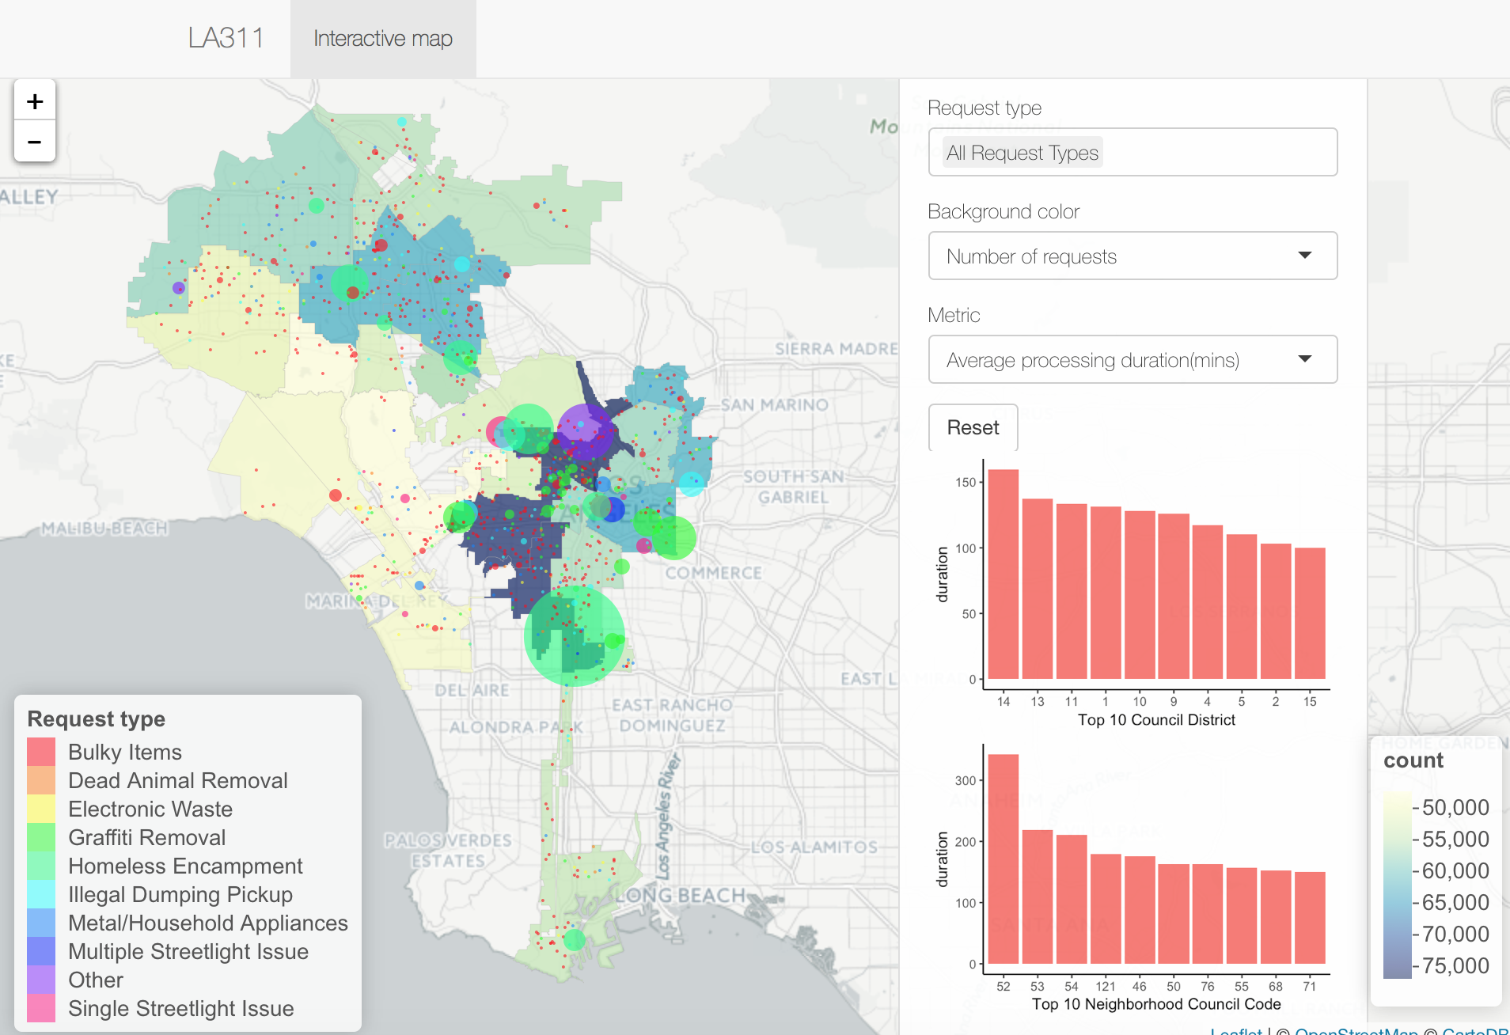
Requests Landscape
Interactive map to observe the pattern of different types of requests by Council District
Colors for the council district polygons display the magnitude for the metrics
Each circle represents a record from the ‘311 Service Request’ dataset
Size of the circle shows the relative magnitude of request processing duration

Slide 6
Requests Landscape - Findings
Generally, the more landward a district is, the more frequent requests occur
CD13, CD10 and CD14 are kind of the areas we need to pay more attention to
NC55 has largest requests count and NC52 has a significant longest average request processing duration

Slide 7
Time Based Analysis

Slide 8
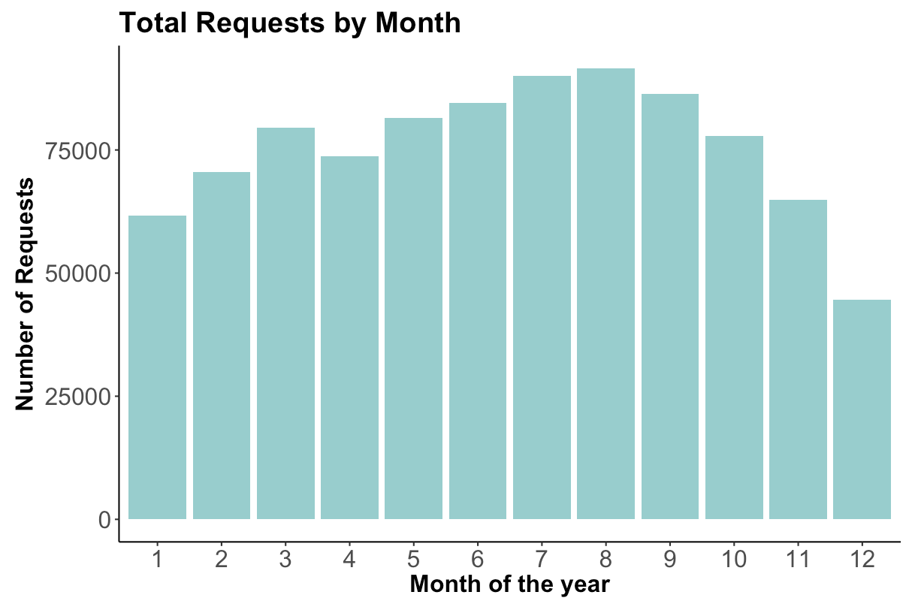
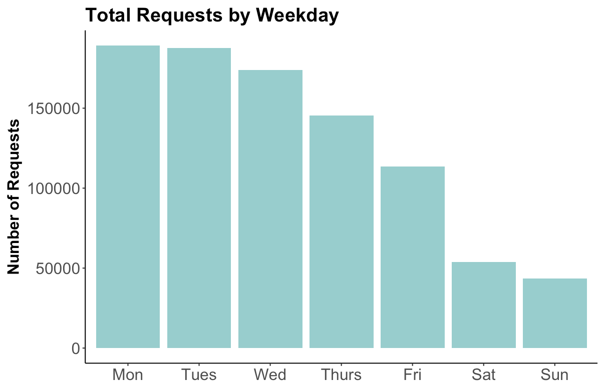
Distribution of Requests
More requests are made during summer, fewer requests during winter
People tend to be more active in summer than in winter
Fewer requests in November and December because of holidays (Thanksgiving, Christmas)
More requests on weekdays, fewer on weekends

Slide 9
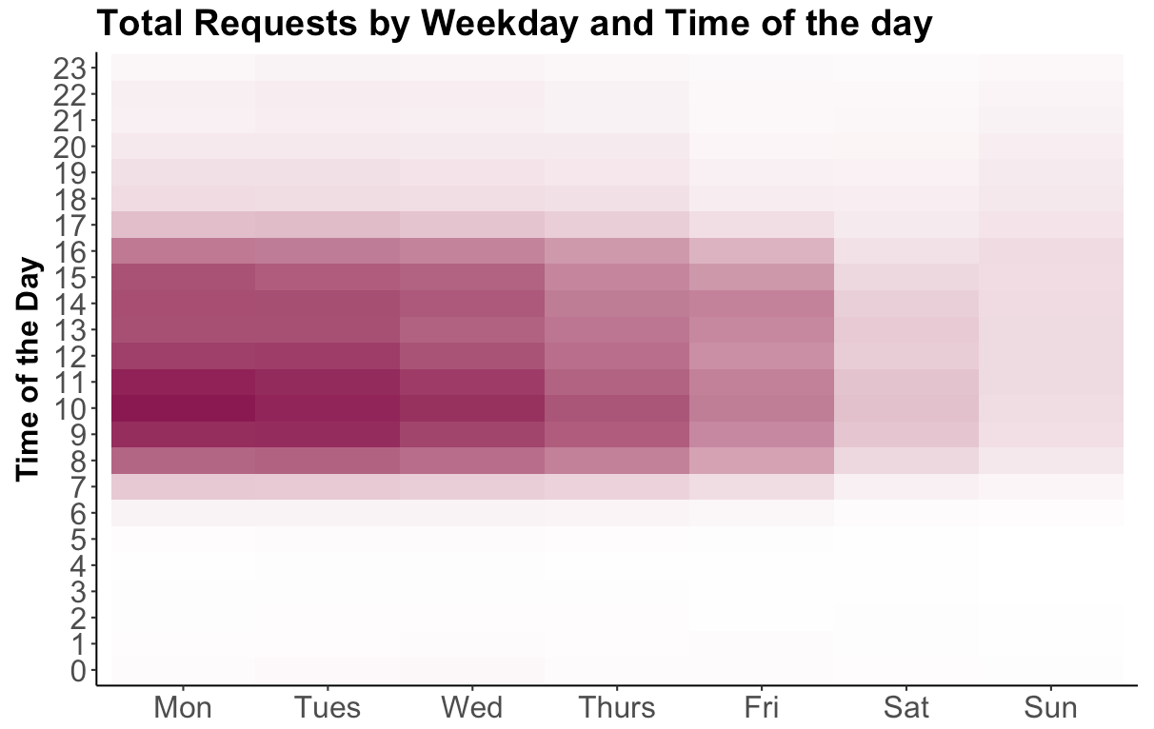
Distribution of Requests
Most requests are made during working hours (from 7am to 5pm) and during weekdays (Monday through Friday)
This might be related with City of LA employees’ working hours. More requests are created when the City of LA employees are working
People like to submit requests during work

Slide 10
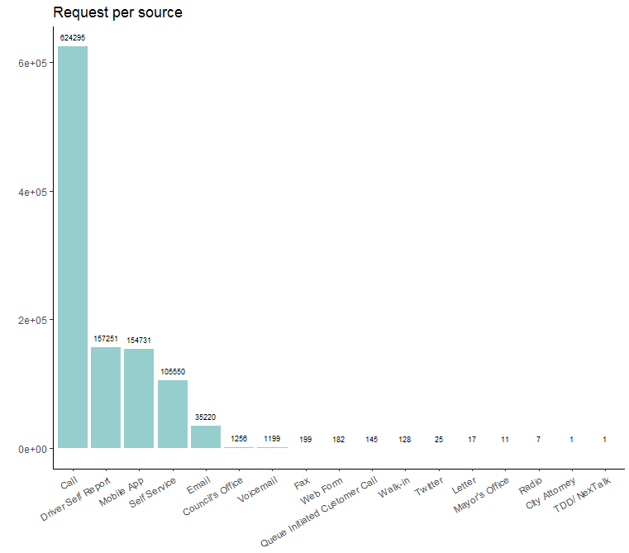
Distribution of Requests
Majority of requests are from phone calls, followed by Driver self report, Mobile App, Self service and Email
Requests from City Attorney and TDD are the least because of their particularity

Slide 11
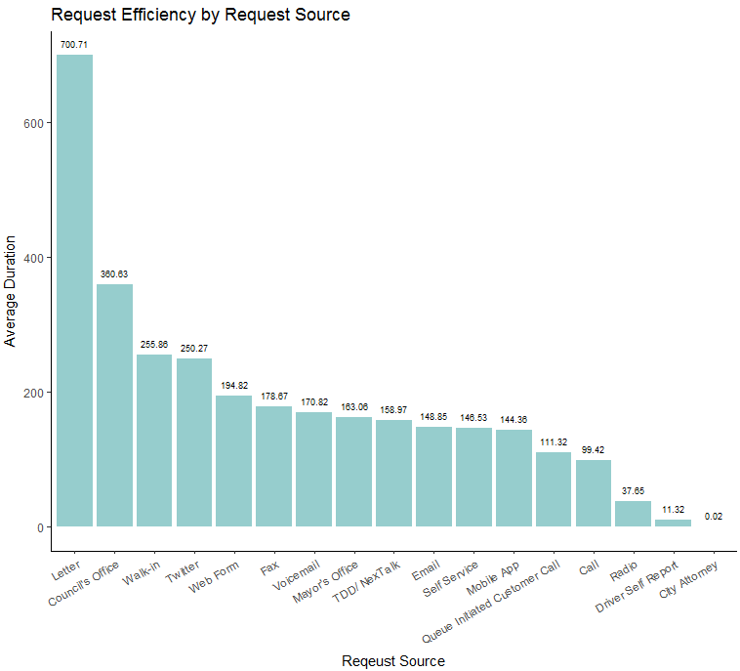
Distribution of Requests
Although most requests are from calls, the average response time is shorter than those from other sources
Most efficient source is Driver Self Report
Calls are more effective than mobile apps
Some samples of sources are too small to conclude general results, and the efficiency also depends on request types to a great extent

Slide 12
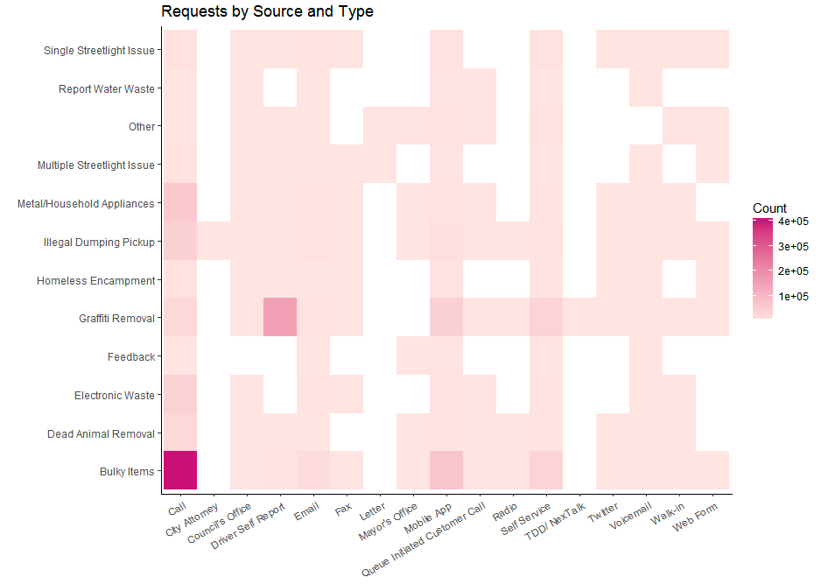
Distribution of Requests
Most popular combination of request type and source is bulky items from call, Graffiti removal from driver self report, bulky items from mobile app and metal/household appliances from call
Sources of call, mobile app, self service, voicemail, and Council’s office are widely used for almost every type of requests though the total count of the last two is small

Slide 13
Efficiency Analysis

Slide 14
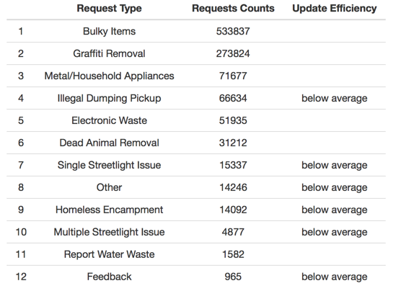
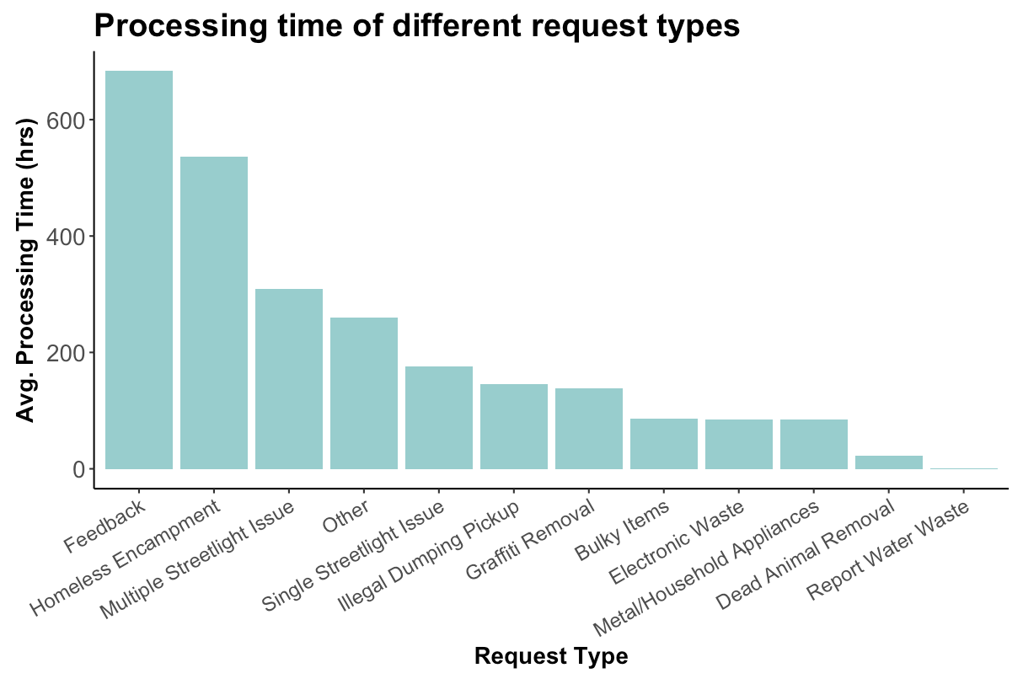

Request Type Efficiency Analysis
Top 3 Most frequent requests: “Bulky Items”, “Graffiti Removal”, “Metal/Household Appliances”
They have above-average update efficiencies
Less frequent requests (e.g. Feedback, Homeless Encampment) need more time to make updates
Possible reason: requests treatment team is familiar with those frequent requests types

Slide 15
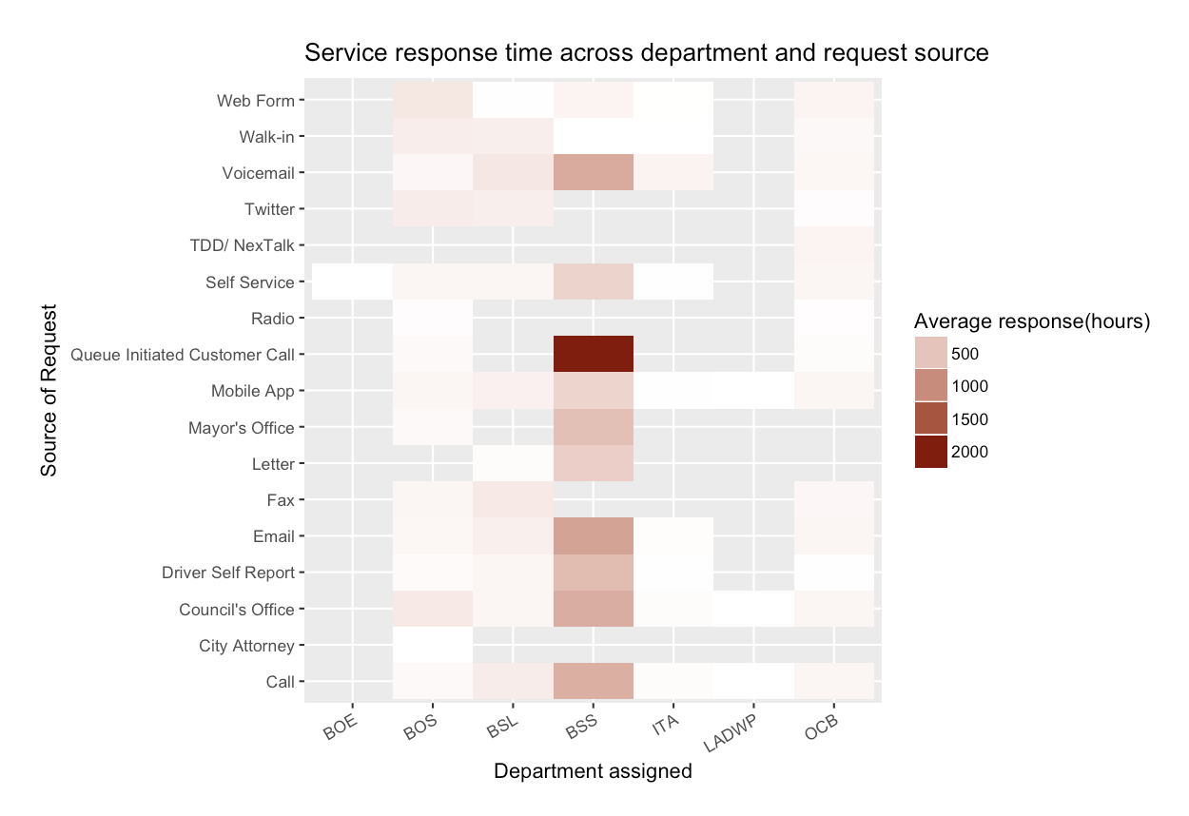
Department Efficiency Analysis
Bureau of Street Services need longest response time compared to other department, especially with request from queue initiated customer call and emails
Office of Community Beautification and Los Angeles Department of Water and Power relatively response quickly to all request sources
Workload of some departments are heavier
Procedure of some request source need to be optimized

Slide 16
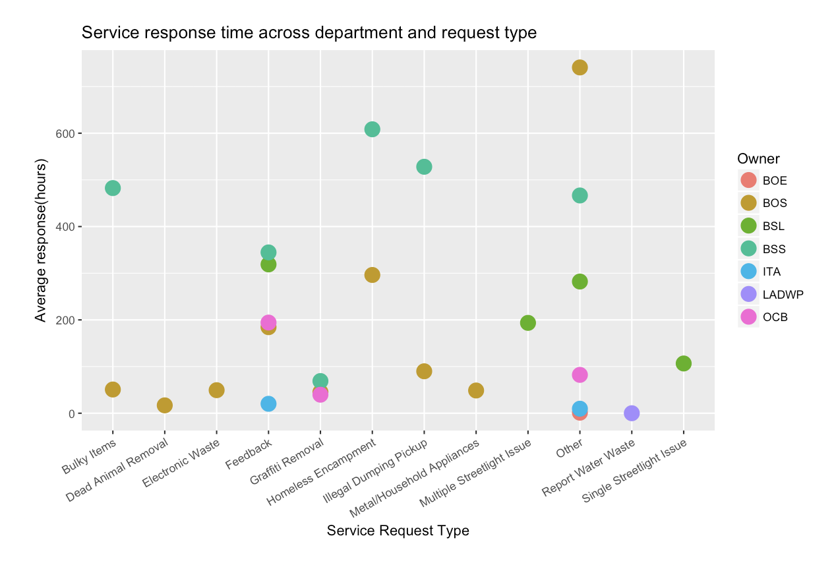
Department Efficiency Analysis
For bulky items ,illegal dumping pickup and homeless encampment, the Board of Supervisors shown faster reactions than Bureau of Street Services
The divergence might resulted from the different individual request situation, but may also provide possibilities to improve service efficiency

Slide 17
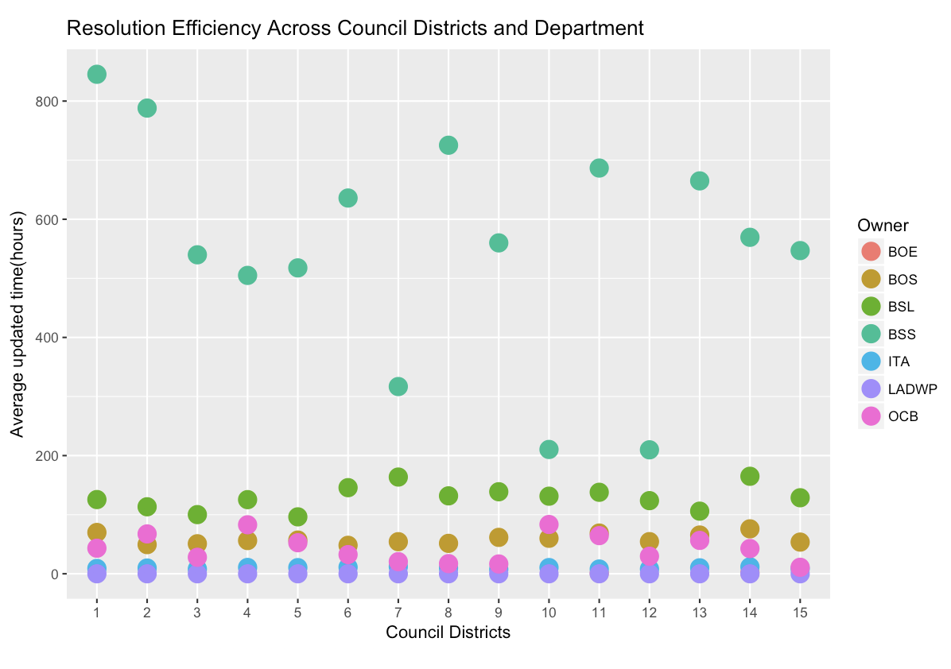
Department Efficiency Analysis
Bureau of Street Services’ average response time is longer than other departments
But in council districts 7,10 and 12, BSS responses quickly
For Bureau of Street Lighting, in council districts 7 and 14, the requests cost more time on average
The reason behind the pattern may be different background of resolution team in different area

Slide 18
Social Analysis

Slide 19
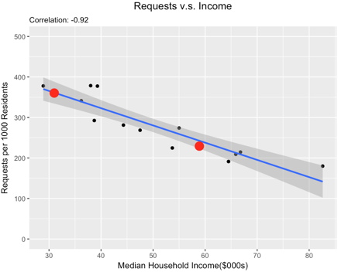
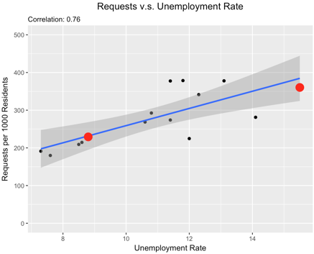
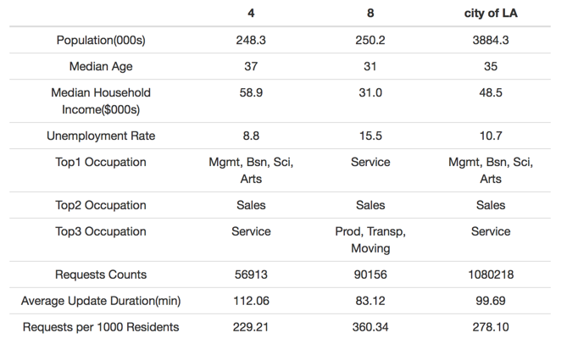
Correlation Analysis
Correlation Analysis on Requests Frequency and Social Characteristics
Median household income and unemployment rate could be two determinations behind frequency of requests
The higher the median household income, the lower the frequency of requests tend to be
Unemployment rate is positively correlated with the frequency of requests

Slide 20
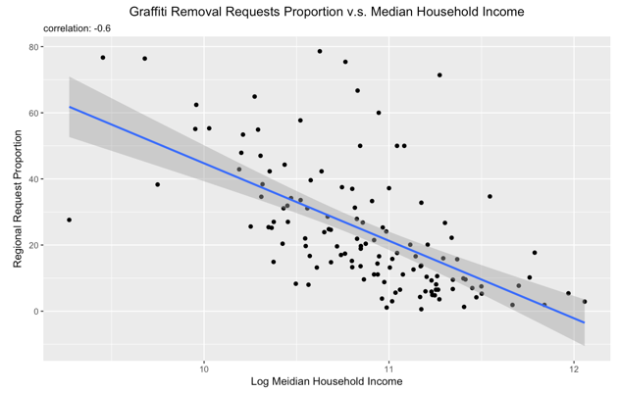
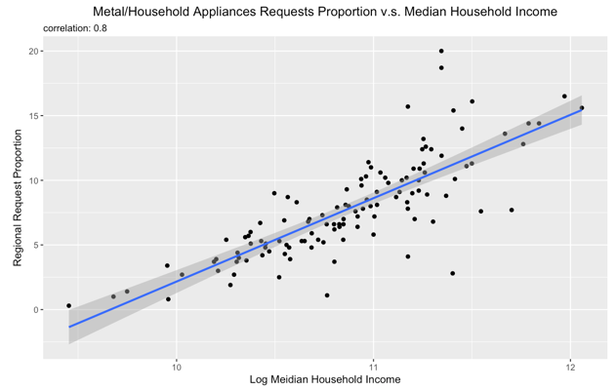
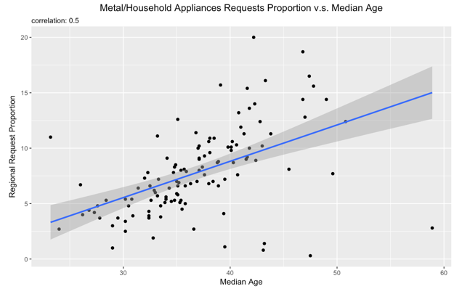
Correlation Analysis
Correlation Analysis on Requests Type and Social Characteristics
Proportion of Graffiti Removal requests is negatively correlated with median income, proportion of Metal/Household Appliances requests is positively correlation with median income and median age
Higher-income people tend not to draw graffiti in public areas, or the higher-income community have better community service. Another possibility is that they are just too busy to pay attention to graffiti
Wealthy people have more Metal/Household Appliances, and change them frequently, and are more willing to send requests to recycle them
Elder people need more help on collecting those appliances

Slide 21
Recommendations

Slide 22
Pay more attention to landward areas
The more landward areas tend to receive more requests and the average processing time for the requests are also longer
May caused by the different geographical properties of those areas
Deploy more specialists in the landward districts rather than the seaward districts
Transfer resources among different departments
The Bureau of Street Services needs longest response time compared to other department, especially with request from queue initiated customer call and emails
The Office of Community Beautification and Los Angeles Department of Water and Power response relatively quick to all request sources
The difference may be caused by the heavy workload for certain departments
May suggest a need of resources transfer from high-efficient departments to low-efficient departments

Slide 23
Establish more efficient procedures for requests that are made less frequent
Less frequent requests have longer processing times on average
Might be related with unfamiliarity of handling those requests
Specialty teams for each request type might help increase request handling efficiency
Consider reallocating recourses on request handling
Higher income areas have significantly fewer number of requests compared with lower income areas; Higher unemployment rate areas have significantly larger number of requests in contrast to low unemployment ones
Allocate more resources to low income and high employment areas
Focus more on low income regions for “Graffiti Removal”
Focus more on high income regions and areas with more elder people for “Metal/Household Appliances”
In general, allocate more resource on “Bulky Items” and “Graffiti Removal”

Slide 24
Thank You!

